Slide 1
It Literally Killed Me
Looking at original texts to learn more about the story

Slide 2
SOTODAYISDIFFERNT
WEAREGOINGTOLOOKATTHEORIGINALGREEKREALIZEOFCOURSETHATGREEKITSELFHADNOTPUNCUATIONORSPACESORLOWERVSUPPERCASELETTERS
Notes:
See if the students can read this

Slide 3
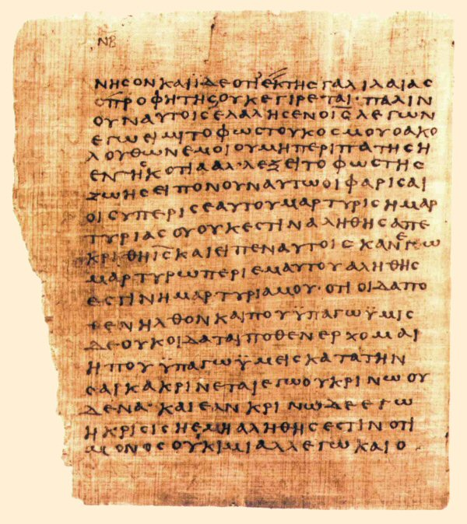
Notes:
Here is an example of a scroll in Greek

Slide 4
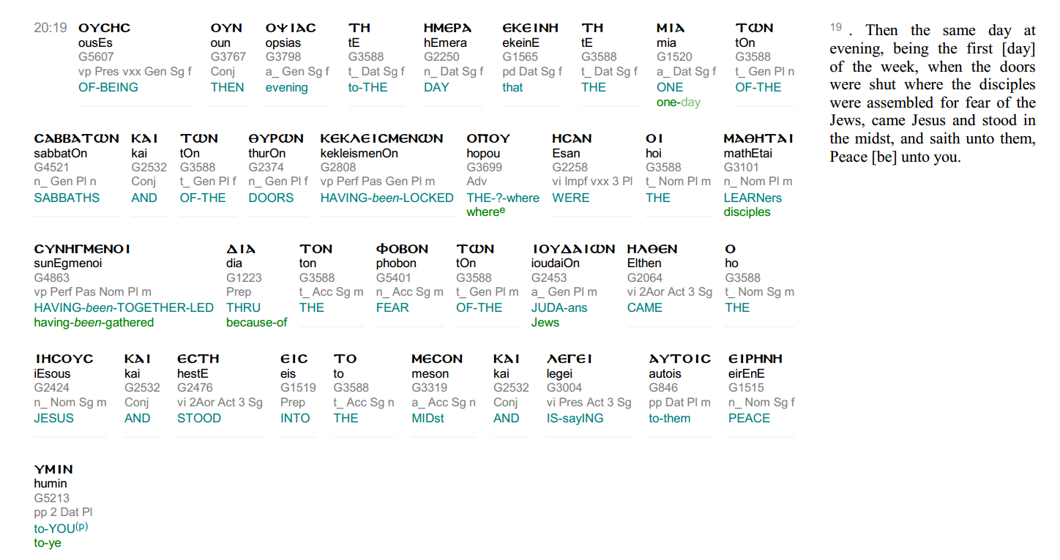
Being Literal
Notes:
Get someone to read this verse. Try to note how the language is different in the translation.
Use the Carl Sagan Chinese translator story.
Have the student’s write down word differences.

Slide 5
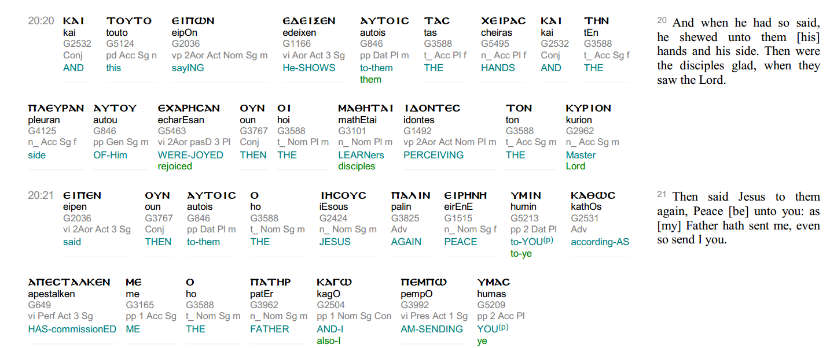
Notes:
Have another student read this (If we have more than 1). Once again look for different words and write down differences.

Slide 6
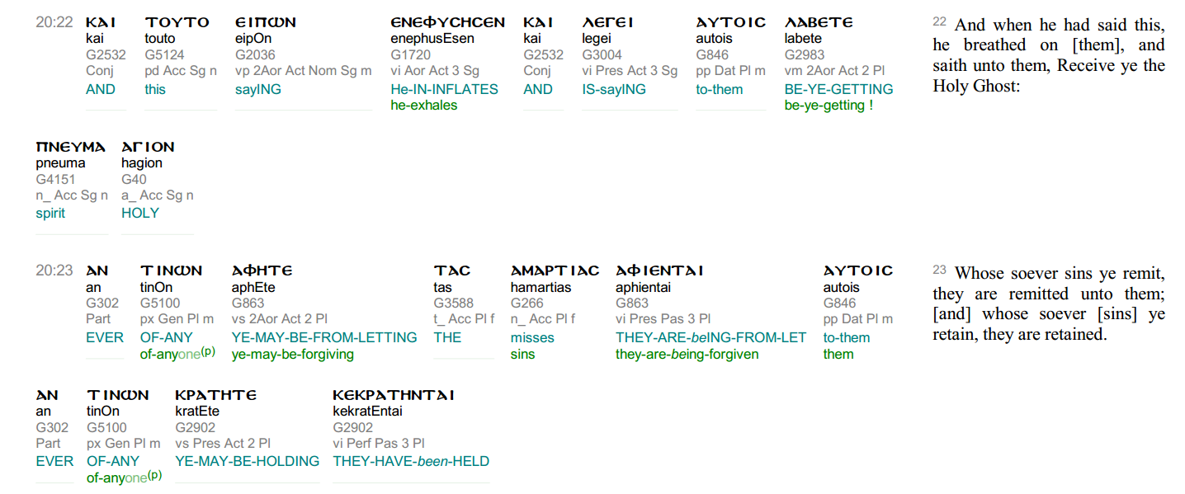
Notes:
Have another student read this (If we have more than 1). Once again look for different words and write down differences.

Slide 7
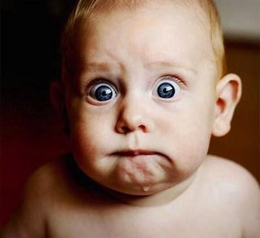
Ok why are they scared?
Notes:
The Crucifixion just happened.
The logic for them Jesus just got killed for blasphemy, his followers would probably be next.

Slide 8
Who are they scared of?
Notes:
The “Jews”. This is not the Hebrews, but the people of Judea. The people of Judea who have got the Romans to crucify Jesus.

Slide 9
What else is different
Notes:
One of the Sabbaths turns into the first day
Learners->Disciples
How about Jesus stood in the midst? Thinking back to the Blind man story is this metaphoric?
Saying to them peace to Ye

Slide 10
What did you see different?
Notes:
Master -> Lord (Talk about more on next slide)
Has Commissioned -> Sent From Male Singular and I

Slide 11
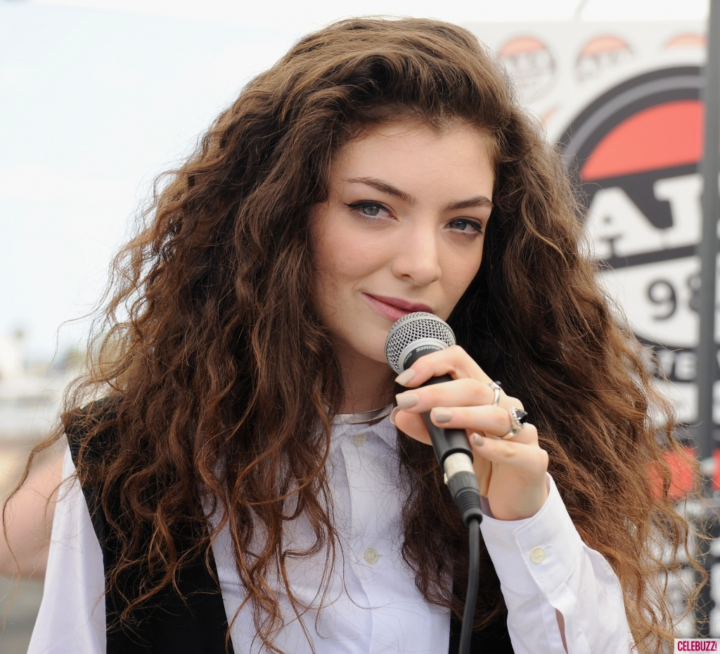
What is a Lord?
Notes:
Comes from Germanic -> Bread Keeper or Loaf Ward
German custom of chieftan providing food to followers
kýrios– A person who has absolute power
Feudalism- A lord could do capital punishment over them (After the French conquest)
In Old Testament, Yhwh is Lord
Greek –adonis to Hebrew Adonai

Slide 12
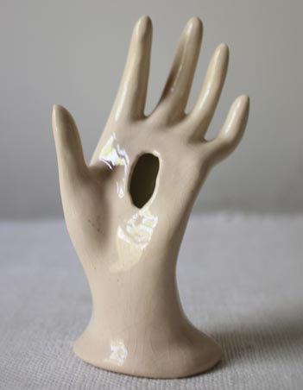
Why the “hole-y” language
Notes:
This is forshadowing for the end of this story where Thomas gets shown the holes in Jesus so he could believe.
Very likely this is put here to discredit Thomas’ gospel. Show sFive Gospels book
Why does Jesus come back still in a bad physical condition?

Slide 13
What did you see different?
Notes:
What differences do you guys find?
He inflates-> to breath (My favorite)
Spirit Holy -> Holy Ghost
Of anyone Ye may be forgiving
Misses ->Sin
Ye-may be holding
They have been held

Slide 14
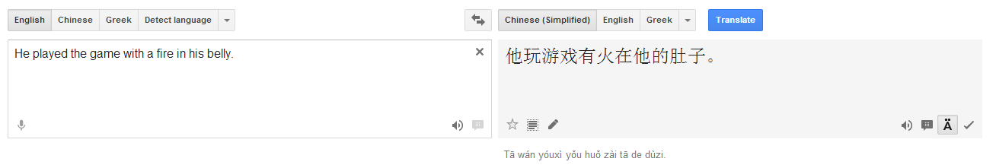
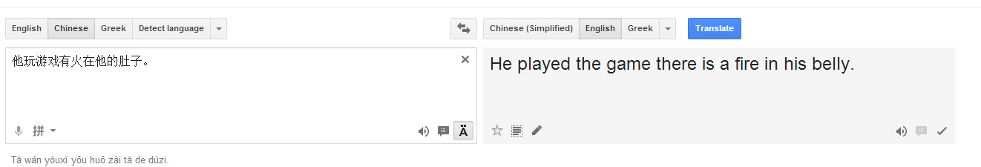
Language is hard
Notes:
Language is one the things any 5 year old can do better than the most sophisticated computer.
See Google Translate not be able to go from English to Chinese back to English.
Sometimes if you are too literal you would miss the point of the original language (As the above shows)

Slide 15
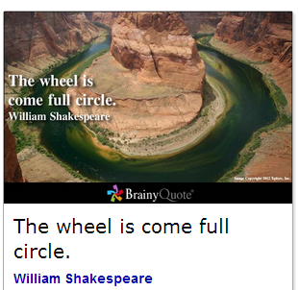
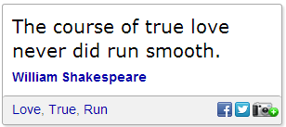
Language Evolves
Notes:
In modern English this sounds wrong.
The wheel has come full circle.
But don’t tell your English teacher!!
The course of true love has never run smoothly.

Slide 16
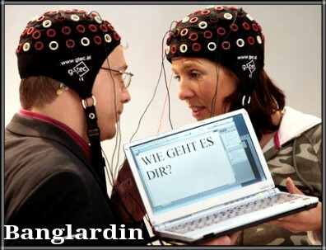
Language is not transfer of thought
Notes:
Every word you speak is bounded by your time in history, the places you are and have been, your social place, and the greater culture.
For example, literally now means de-facto, I am telling the truth.
s
Can you think of way to limit this but still speak persuasively?
Most persuasive language uses metaphors which don’t always transfer well in translation.

Slide 17
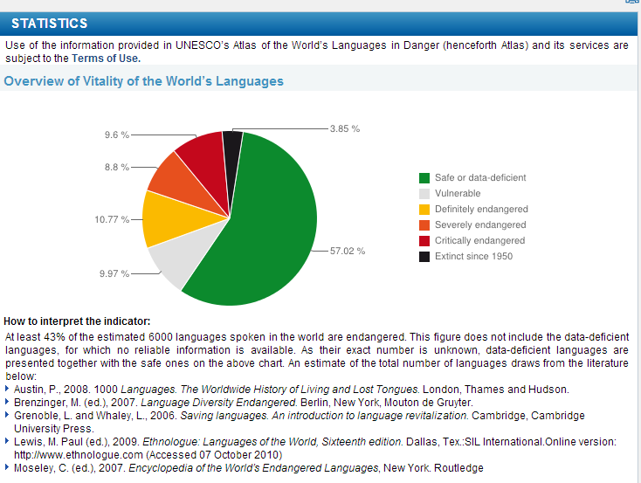
Public Service Announcement
How many languages do you think are in the world?
Notes:
How many languages ? Get some guesses? How many extinct? Get guesses.
Then click.

Slide 18
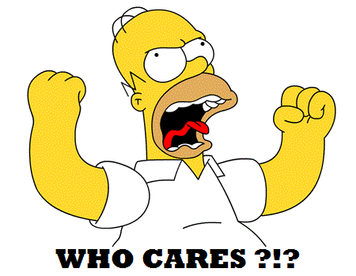
Why do we care?
Notes:
Get some ideas of what people think.
Smart people understand human for their culture.
Carl Sagan -10 fingers hypothesis
Kant- Cardinal Directions
Whorf-Sapir hypothesis- strong and weak
Daniel Everett- Can’t translate the Bible into Piraha (Amazon Tribe)
Can go into why if interest abounds

Slide 19
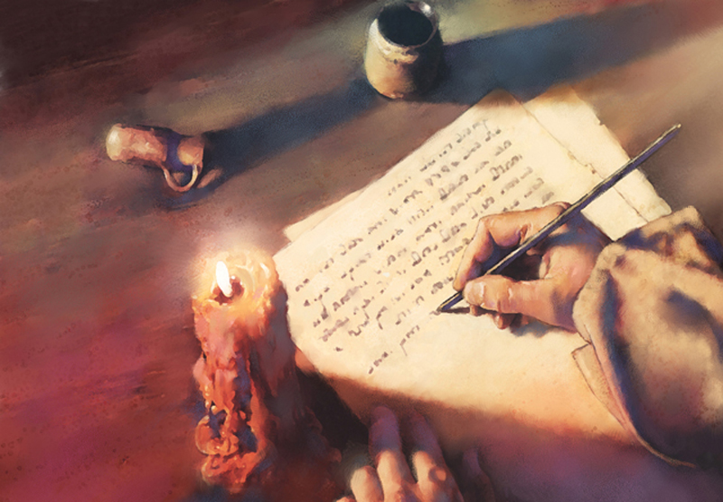
So how do WE write the Bible?
Notes:
We can’t do it literally. The text is very bounded by culture and the translations are bounded by their own culture.
Do we add some background text like a College reader or The Five Gospels?
Do we translate it into metaphors that we understand right now? If so, do we constantly change it? Are there many correct texts then?

